Slide 1
Red Team Final Engagement
Attack, Defense & Analysis of a Vulnerable Network
Notes:
Good Evening and Welcome

Slide 2
Table of Contents
This document contains the following resources:
Network Topology & Critical Vulnerabilities
Exploits Used
Methods Used to Avoid Detection
Notes:
3 Facets Include

Slide 3

Network Topology
& Critical Vulnerabilities
3
Notes:
Architecture and Vulnerabilities

Slide 4
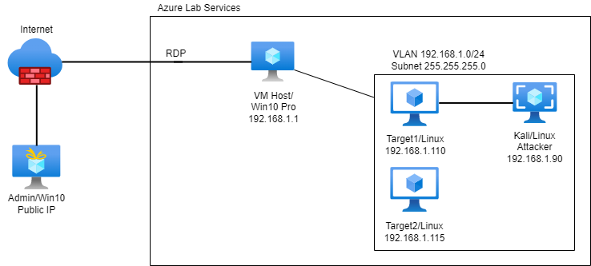
Network Topology
Network
Address Range: 192.168.1-255
Netmask: 255.255.255.0
Broadcast: 192.168.1.255
Machines
IPv4: 192.168.1.110
OS: Debian 3.16.57-2
Hostname: Target1
IPv4:192.168.1.115
OS: Debian 3.16.57-2
Hostname: Target2
IPv4: 192.168.1.1
OS: Windows 10 Pro
VM Hostname: ML-RefVm-684427
IPv4:192.168.1.90
OS: Debian 5.4.13-1kali1
Hostname: Kali
L.Joe, E.Yarnell
Notes:
Welcome to the Dream within a Dream within a Dream

Slide 5
Critical Vulnerabilities [Target 1]
Our assessment uncovered the following critical vulnerabilities in Target 1:
Vulnerability | Description | Impact
Apache HTTP Server 2.4.10 | Port 80 open detected vulnerable version of Apache | An attacker could use a path traversal attack to map URLs to files outside the directories configured by alias-like directives
OpenSSH 6.7 p1 | Port scan 22 discovered vulnerable version of OpenSSH | OpenSSH before 7.2p2 allowed remote authenticated users to bypass intended shell command restrictions
WordPress 4.8.17 | WordPress advertently vulnerable by default | Due to vulnerabilities of WordPress it would need to be baselined to harden the system
L.Joe

Slide 6
Exploits Used
6
Notes:
Exploits

Slide 7
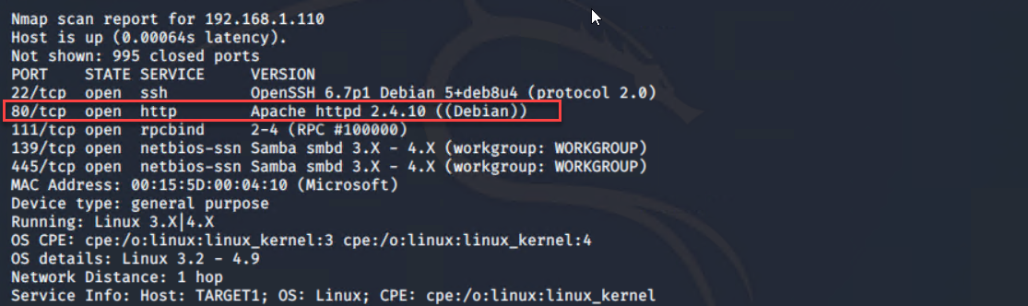
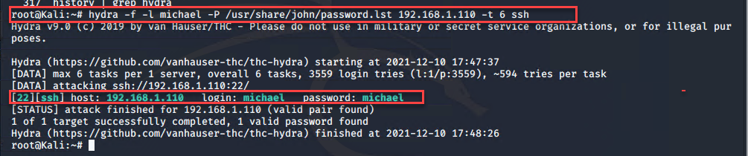
Exploitation: [Apache HTTP Server 2.4.10]
Summarize the following:
How did you exploit the vulnerability? nmap -sSV -O 192.168.1.1-255
What did the exploit achieve? Determined port 80 and vulnerable version of Apache would allow traversal of directory to /var/www on server
L.Joe
Notes:
Talk about nmap scanning on 192.168.1.110, options.

Slide 8
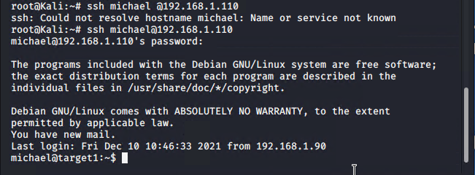
Exploitation: [OpenSSH 6.7 pl ]
Summarize the following:
How did you exploit the vulnerability? ssh michael@192.168.1.110
What did the exploit achieve? This exploitation allows the bad actor to gain direct access to the login of user. In this case, Michael
E.Idowu
Notes:
After nmap scan, found that SSH port was open.

Slide 9
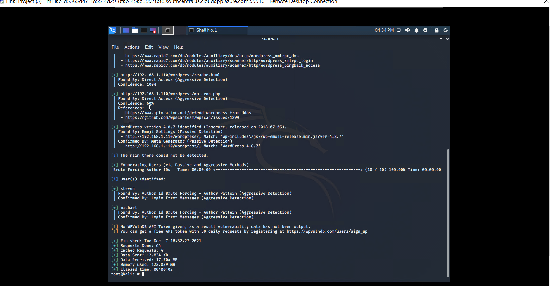
Exploitation: WordPress
Summary: < wpscan –url http://192.168.1.110/wordpress -eu >
An open source WordPress security tool (WPscan) was run out of Kali Linux
Two author IDs were revealed during the scan via a Brute Forcing technique
E.Yarnell

Slide 10
Avoiding Detection
10
Notes:
Avoiding Detection

Slide 11
Stealth Exploitation of [Apache HTTP Server 2.4.10]
Monitoring Overview
An alert was triggered in Kibana on the Excessive HTTP Errors alert
The measured parameter is http_response.status.codes
When the count grouped over top 5 http_response.status.code is over 400 in the last 5 minutes, an alert fires
Mitigating Detection
In Hydra you can use the -W flag which creates a wait time between each password guess. The pw-inspector flag also reduces the password list
Password Guessing, Apache Memory Leak
J.Gaitan, L.Joe

Slide 12
Stealth Exploitation of [OpenSSH 6.7 p1]
Monitoring Overview
An alert to email the analyst for any SSH login
Connections to port 22
For any connection to the SSH protocol, an alert fires
Mitigating Detection
Create an undetectable SSH backdoor python script | Create an SSH tunnel
https://github.com/grassmeight/SSH-Backdoor
A.Parson

Slide 13
Stealth Exploitation of WordPress
Monitoring Overview
An alert was triggered in Kibana on the HTTP Request Size Monitor
The measured parameter is HTTP requested bytes over all server documents
When the sum of requested bytes exceeds 3500 in the last minute, an alert fires
Mitigating Detection
WPscan also offers a stealth mode, i.e. < wpscan –url http://192.168.1.110/wordpress –stealthy >
“The easiest and most reliable way to import and export WordPress users is by using a plugin. These will let you export users from one WordPress site to a file you download to your computer, then upload that file to import users to the new site.” [kinsta.com]
E.Yarnell

Slide 14
FIN
14
Notes:
FIN-ACK

